Slide 1
Concentration, Randomized Algorithms
 | Miles Jones | MTThF 8:30-9:50am | CSE 4140
August 30, 2016

Slide 2
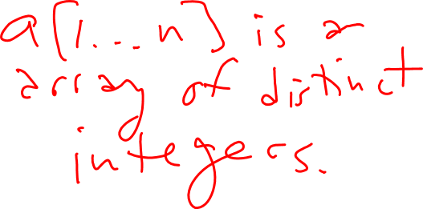
Useful trick 2: Linearity of expectation
Example: Consider the following program:
Findmax(a[1…n])
max:=a[1]
for i=2 to n
if a[i]>max then
max:=a[i]
return max
If the array is in a random order, how many times do we expect max to change?

Slide 3
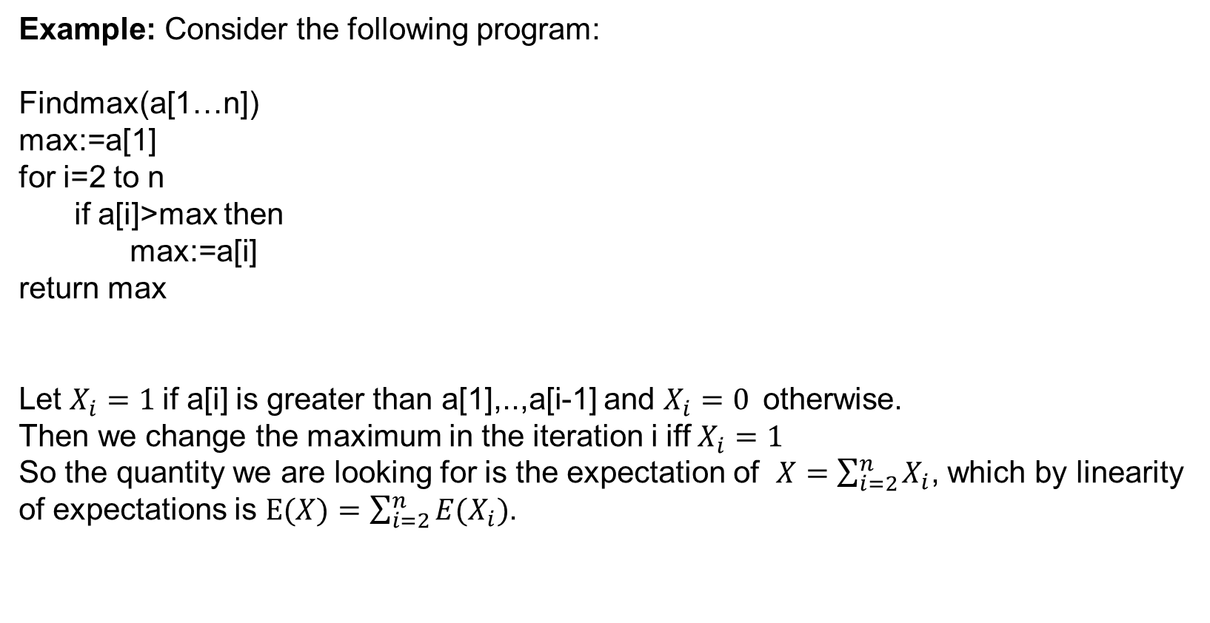
Useful trick 2: Linearity of expectation
Example: Consider the following program:
Findmax(a[1…n])
max:=a[1]
for i=2 to n
if a[i]>max then
max:=a[i]
return max
Let $X_{i}=1$if a[i] is greater than a[1],..,a[i-1] and $X_{i}=0$otherwise.
Then we change the maximum in the iteration i iff $X_{i}=1$
So the quantity we are looking for is the expectation of $X=\sum_{i=2}^{n}{X_{i}}$, which by linearity of expectations is $E(X)=\sum_{i=2}^{n}{E(X_{i})}$.

Slide 4
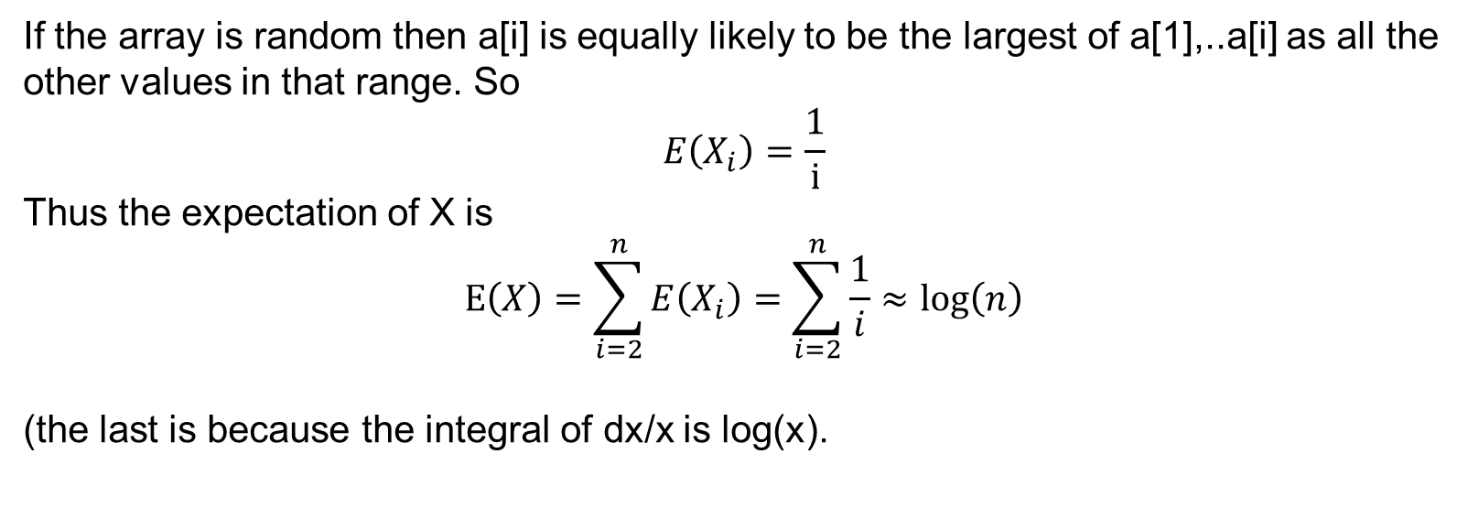
Useful trick 2: Linearity of expectation
If the array is random then a[i] is equally likely to be the largest of a[1],..a[i] as all the other values in that range. So
$$E\left(X_{i}\right)=\frac{1}{i}$$
Thus the expectation of X is
$$E\left(X\right)=\sum_{i=2}^{n}{E\left(X_{i}\right)}=\sum_{i=2}^{n}{\frac{1}{i}}≈\log\left(n\right)$$
(the last is because the integral of dx/x is log(x).

Slide 5
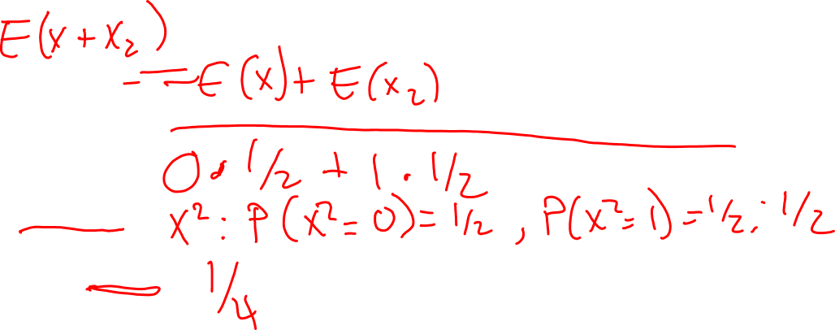
Other functions?
Rosen p. 460,478
Expectation does not in general commute with other functions.
E ( f(X) ) ≠ f ( E (X) )
For example, let X be random variable with P(X = 0) = ½ , P(X =1) = ½
What's E(X)?
What's E(X²)?
What's ( E(X) )²?

Slide 6
Other functions?
Rosen p. 460,478
Expectation does not in general commute with other functions.
E ( f(X) ) ≠ f ( E (X) )
For example, let X be random variable with P(X = 0) = ½ , P(X =1) = ½
What's E(X)? (½)0 + (½)1 = ½
What's E(X²)? (½)0² + (½)1² = ½
What's ( E(X) )²? (½)² = ¼

Slide 7
Independent Events
Rosen p. 457
Two events E and F are independent iff P( E F ) = P(E) P(F).
Problem: Suppose
E is the event that a randomly generated bitstring of length 4 starts with a 1
F is the event that this bitstring contains an even number of 1s.
Are E and F independent if all bitstrings of length 4 are equally likely? Are they disjoint?
U
First impressions?
E and F are independent and disjoint.
E and F are independent but not disjoint.
E and F are disjoint but not independent.
E and F are neither disjoint nor independent.

Slide 8
Independent Events
Rosen p. 457
Two events E and F are independent iff P( E F ) = P(E) P(F).
Problem: Suppose
E is the event that a randomly generated bitstring of length 4 starts with a 1
F is the event that this bitstring contains an even number of 1s.
Are E and F independent if all bitstrings of length 4 are equally likely? Are they disjoint?
U

Slide 9
Independent Random Variables
Rosen p. 485
U
Let X and Y be random variables over the same sample space. X and Y are called independent random variables if, for all possible values of v and u,
P ( X = v and Y = u ) = P ( X = v) P(Y = u)
Which of the following pairs of random variables on sample space of sequences of H/T when coin is flipped four times are independent?
X₁₂ = # of H in first two flips, X₃₄ = # of H in last two flips.
X = # of H in the sequence, Y = # of T in the sequence.
X₁₂ = # of H in first two flips, X = # of H in the sequence.
None of the above.

Slide 10

Independence
Rosen p. 486
Theorem:
If X and Y are independent random variables over the same sample space, then
E ( X Y ) = E( X ) E( Y )
Note: This is not necessarily true if the random variables are not independent!

Slide 11
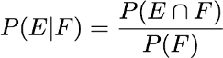
Recall: Conditional probabilities
Probability of an event may change if have additional information about outcomes.
Suppose E and F are events, and P(F)>0. Then,
i.e.
Rosen p. 456

Slide 12
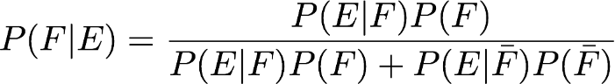
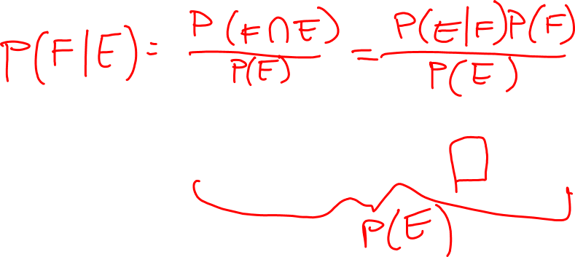
Bayes' Theorem
Rosen Section 7.3
Based on previous knowledge about how probabilities of two events relate
to one another, how does knowing that one event occurred impact the probability that the other did?

Slide 13
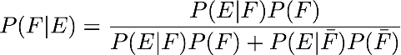
Bayes' Theorem: Example 1
Rosen Section 7.3
A manufacturer claims that its drug test will detect steroid use 95% of the time. What the company does not tell you is that 15% of all steroid-free individuals also test positive (the false positive rate). 10% of the Tour de France bike racers use steroids. Your favorite cyclist just tested positive. What’s the probability that he used steroids?
Your first guess?
Close to 95%
Close to 85%
Close to 15%
Close to 10%
Close to 0%

Slide 14
Bayes' Theorem: Example 1
Rosen Section 7.3
A manufacturer claims that its drug test will detect steroid use 95% of the time. What the company does not tell you is that 15% of all steroid-free individuals also test positive (the false positive rate). 10% of the Tour de France bike racers use steroids. Your favorite cyclist just tested positive. What’s the probability that he used steroids?
Define events: we want P ( used steroids | tested positive)

Slide 15
Bayes' Theorem: Example 1
Rosen Section 7.3
A manufacturer claims that its drug test will detect steroid use 95% of the time. What the company does not tell you is that 15% of all steroid-free individuals also test positive (the false positive rate). 10% of the Tour de France bike racers use steroids. Your favorite cyclist just tested positive. What’s the probability that he used steroids?
Define events: we want P ( used steroids | tested positive) so let
E = Tested positive
F = Used steroids

Slide 16
Bayes' Theorem: Example 1
Rosen Section 7.3
A manufacturer claims that its drug test will detect steroid use 95% of the time.
What the company does not tell you is that 15% of all steroid-free individuals also test positive (the false positive rate). 10% of the Tour de France bike racers use steroids. Your favorite cyclist just tested positive. What’s the probability that he used steroids?
Define events: we want P ( used steroids | tested positive)
E = Tested positive P( E | F ) = 0.95
F = Used steroids

Slide 17
Bayes' Theorem: Example 1
Rosen Section 7.3
A manufacturer claims that its drug test will detect steroid use 95% of the time.
What the company does not tell you is that 15% of all steroid-free individuals also test positive (the false positive rate). 10% of the Tour de France bike racers use steroids. Your favorite cyclist just tested positive. What’s the probability that he used steroids?
Define events: we want P ( used steroids | tested positive)
E = Tested positive P( E | F ) = 0.95
F = Used steroids P(F) = 0.1 P( ) = 0.9

Slide 18
Bayes' Theorem: Example 1
Rosen Section 7.3
A manufacturer claims that its drug test will detect steroid use 95% of the time. What the company does not tell you is that 15% of all steroid-free individuals also test positive (the false positive rate). 10% of the Tour de France bike racers use steroids. Your favorite cyclist just tested positive. What’s the probability that he used steroids?
Define events: we want P ( used steroids | tested positive)
E = Tested positive P( E | F ) = 0.95 P( E | ) = 0.15
F = Used steroids P(F) = 0.1 P( ) = 0.9

Slide 19
Bayes' Theorem: Example 1
Rosen Section 7.3
A manufacturer claims that its drug test will detect steroid use 95% of the time. What the company does not tell you is that 15% of all steroid-free individuals also test positive (the false positive rate). 10% of the Tour de France bike racers use steroids. Your favorite cyclist just tested positive. What’s the probability that he used steroids?
Define events: we want P ( used steroids | tested positive)
E = Tested positive P( E | F ) = 0.95 P( E | ) = 0.15
F = Used steroids P(F) = 0.1 P( ) = 0.9
Plug in:
41%

Slide 20
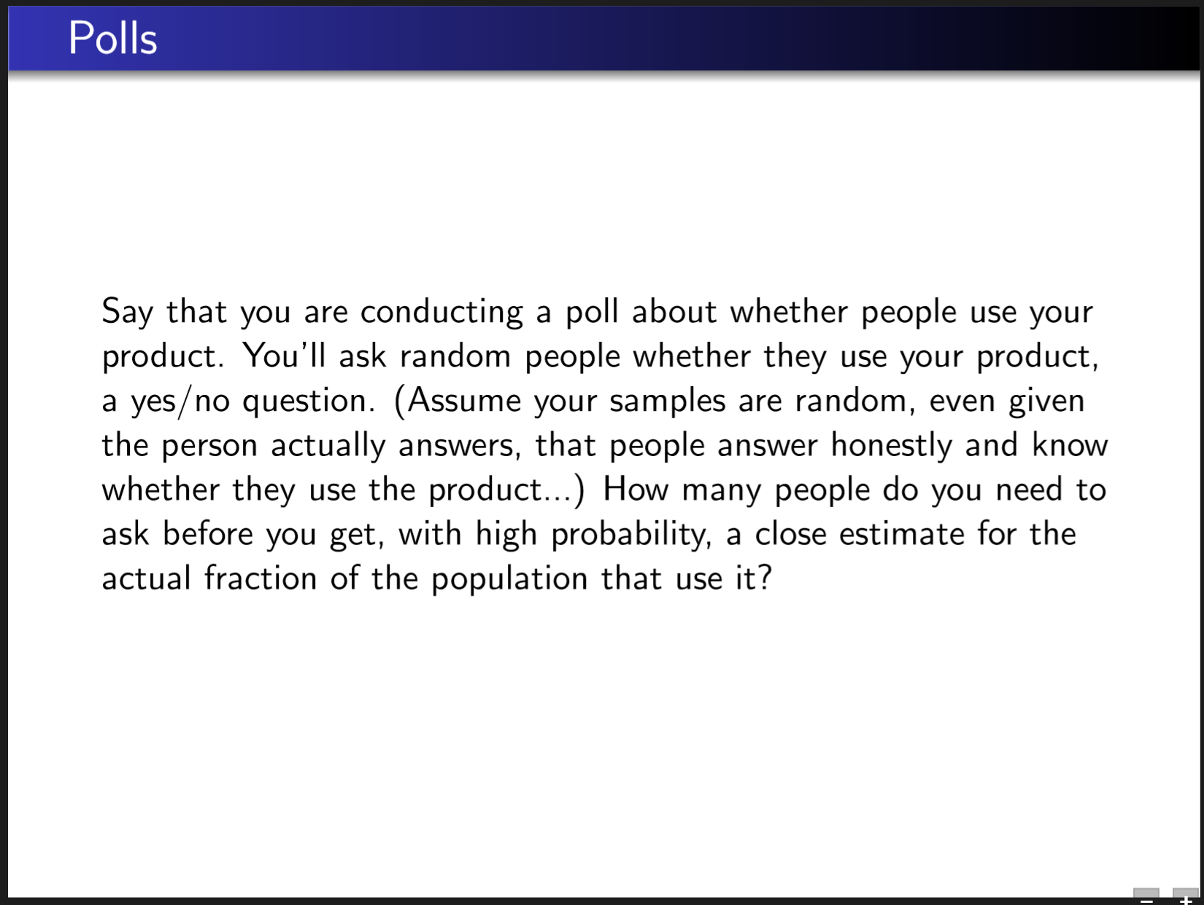

Slide 21
Concentration
Rosen Section 7.4
How close (on average) will we be to the average / expected value?
Let X be a random variable with E(X) = E.
The unexpectedness of X is the random variable
U = |X-E|
The average unexpectedness of X is
AU(X) = E ( |X-E| ) = E( U )
The variance of X is
V(X) = E( |X – E|² ) = E ( U² )
The standard deviation of X is
σ(X) = ( E( |X – E|² ) )^{1/2} = V(X)^{1/2}

Slide 22
Concentration
How close (on average) will we be to the average / expected value?
Let X be a random variable with E(X) = E.
The variance of X is
V(X) = E( |X – E|² ) = E ( U² )
Example: X₁ is a random variable with distribution
P( X₁ = -2 ) = 1/5, P( X₁ = -1 ) = 1/5, P( X₁ = 0 ) = 1/5, P( X₁ = 1 ) = 1/5, P( X₁ = 2 ) = 1/5.
X₂ is a random variable with distribution
P( X₂ = -2 ) = 1/2, P( X₂ = 2 ) = ½.
Which is true?
E(X₁) ≠ E(X₂)
V(X₁) < V(X₂)
V(X₁) > V(X₂)
V(X₁) = V(X₂)

Slide 23
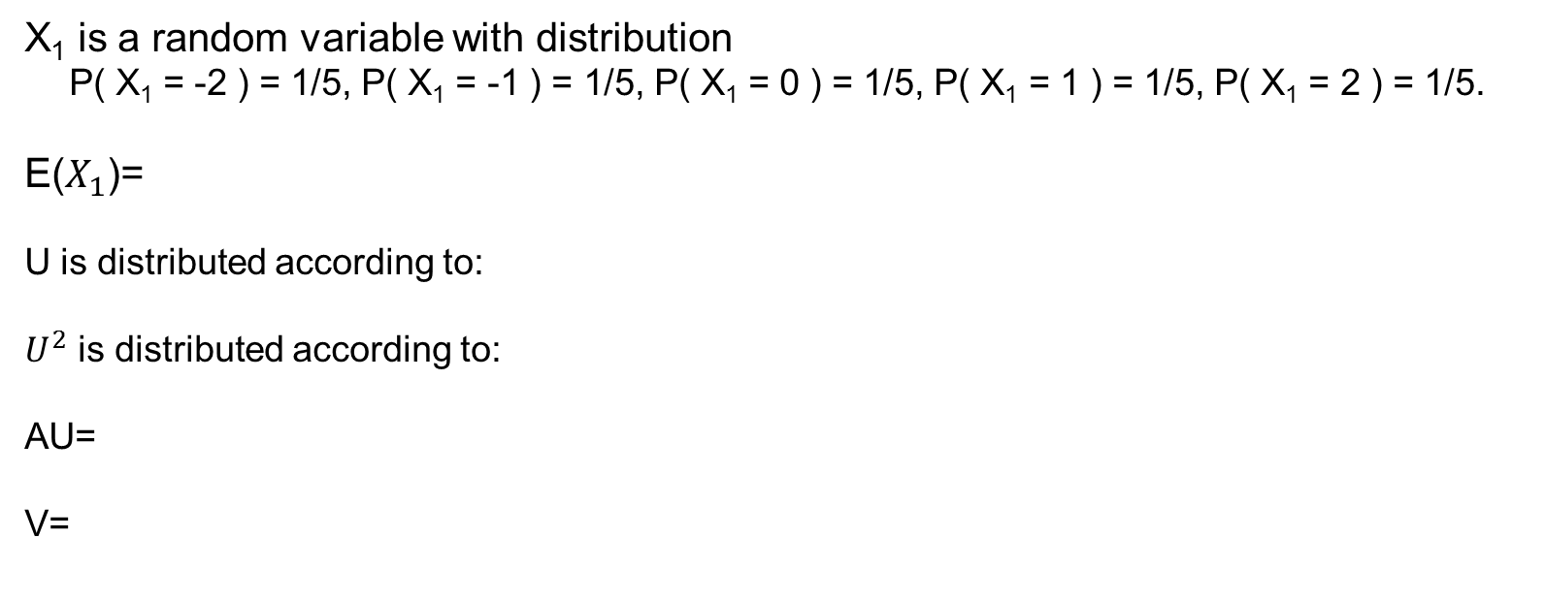
X₁ is a random variable with distribution
P( X₁ = -2 ) = 1/5, P( X₁ = -1 ) = 1/5, P( X₁ = 0 ) = 1/5, P( X₁ = 1 ) = 1/5, P( X₁ = 2 ) = 1/5.
E($X_{1}$)=
U is distributed according to:
$U^{2}$ is distributed according to:
AU=
V=

Slide 24
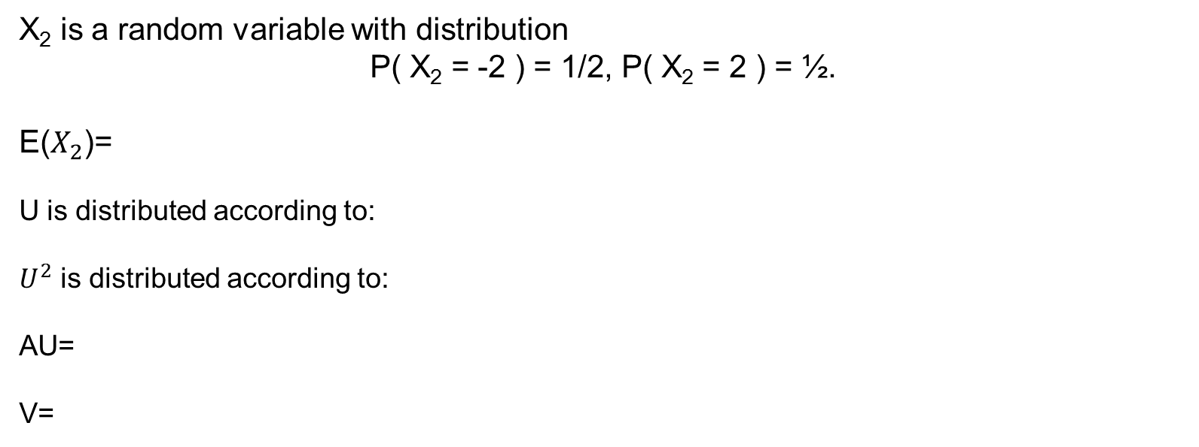
X₂ is a random variable with distribution
P( X₂ = -2 ) = 1/2, P( X₂ = 2 ) = ½.
E($X_{2}$)=
U is distributed according to:
$U^{2}$ is distributed according to:
AU=
V=

Slide 25
Concentration
How close (on average) will we be to the average / expected value?
Let X be a random variable with E(X) = E.
The unexpectedness of X is the random variable
U = |X-E|
The average unexpectedness of X is
AU(X) = E ( |X-E| ) = E( U )
The variance of X is
V(X) = E( |X – E|² ) = E ( U² )
The standard deviation of X is
σ(X) = ( E( |X – E|² ) )^{1/2} = V(X)^{1/2}
Weight all differences from mean equally
Weight large differences from mean more

Slide 26
Concentration
How close (on average) will we be to the average / expected value?
Let X be a random variable with E(X) = E.
The variance of X is
V(X) = E( |X – E|² ) = E ( U² )
Theorem: V(X) = E(X²) – ( E(X) )²

Slide 27
Concentration
How close (on average) will we be to the average / expected value?
Let X be a random variable with E(X) = E.
The variance of X is
V(X) = E( |X – E|² ) = E ( U² )
Theorem: V(X) = E(X²) – ( E(X) )²
Proof: V(X) = E( (X-E)² ) = E( X² – 2XE + E²) = E(X²) – 2E E (X) + E²
= E(X²) – 2E² + E²
= E(X²) – ( E(X) )² ☺
Linearity of expectation

Slide 28
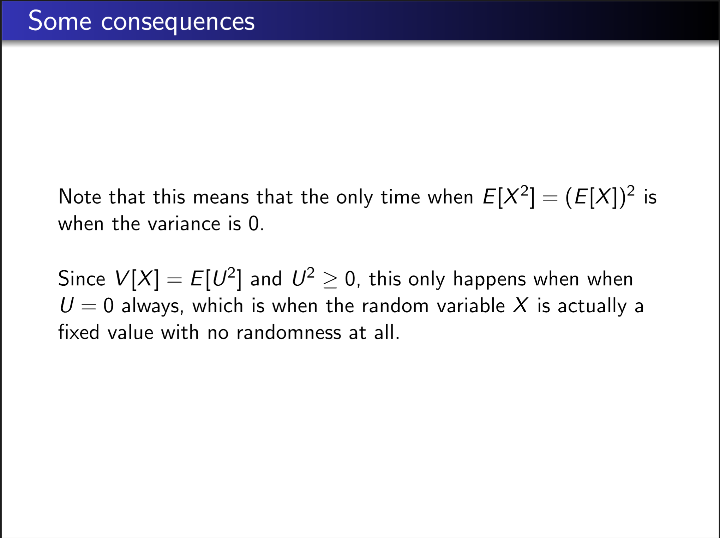

Slide 29
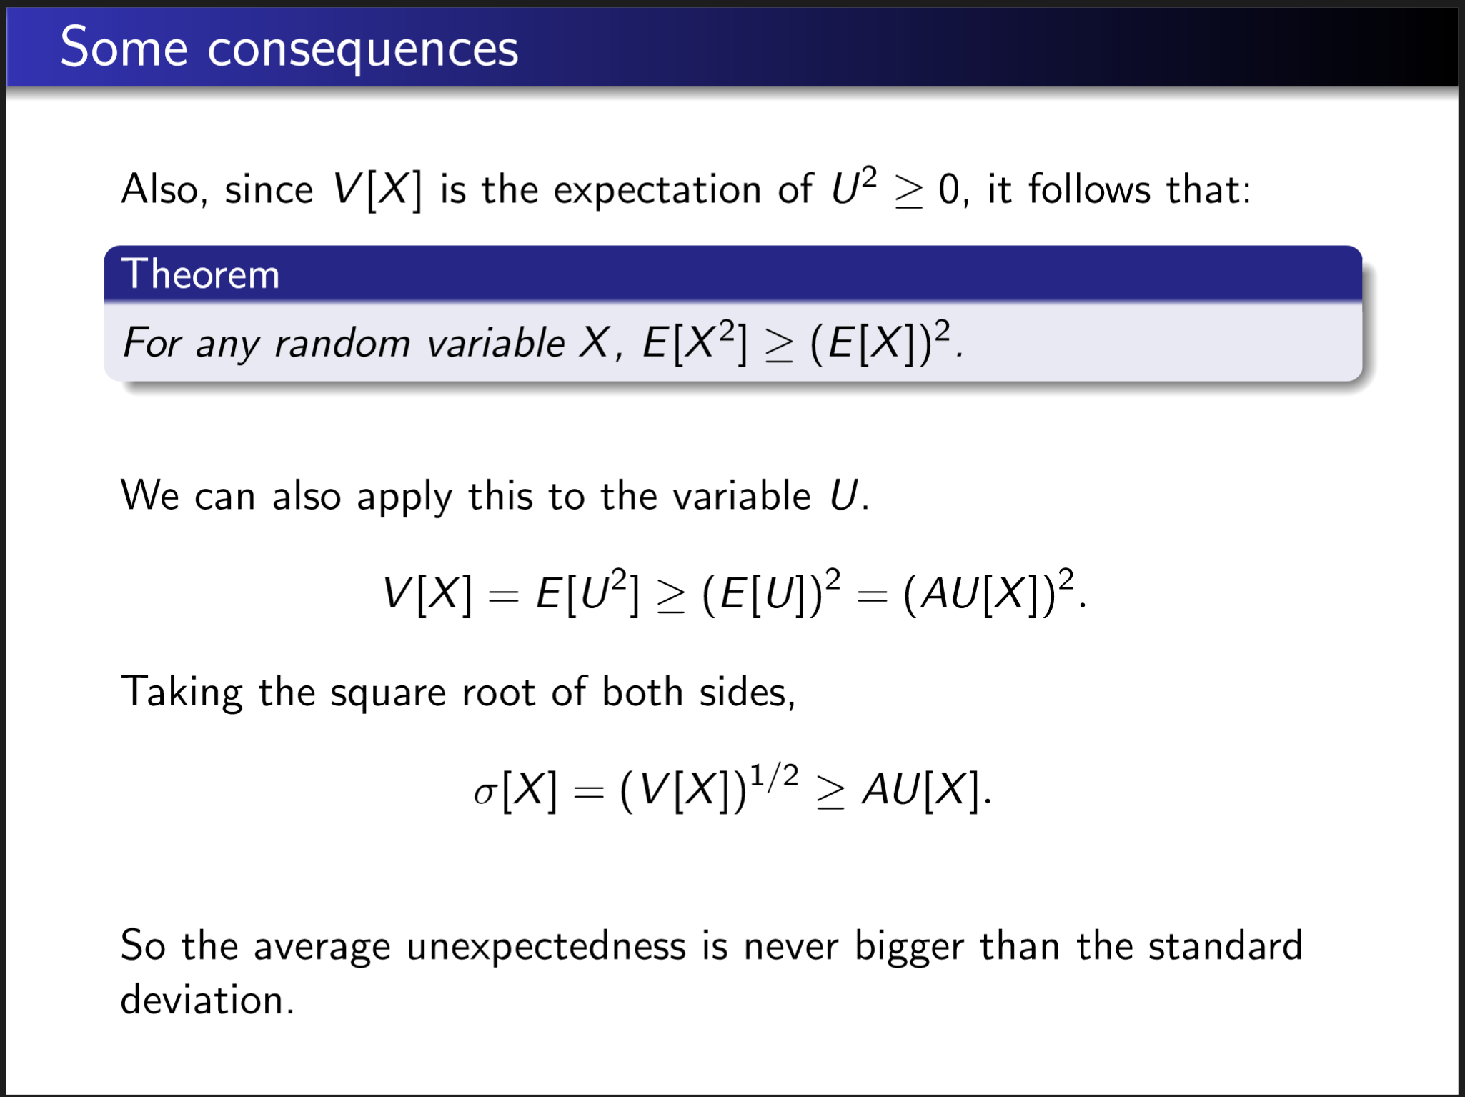

Slide 30
Standard Deviation
The standard deviation gives us a bound on how far off we are likely to be from the expected value. It is frequently but not always a fairly accurate bound.

Slide 31
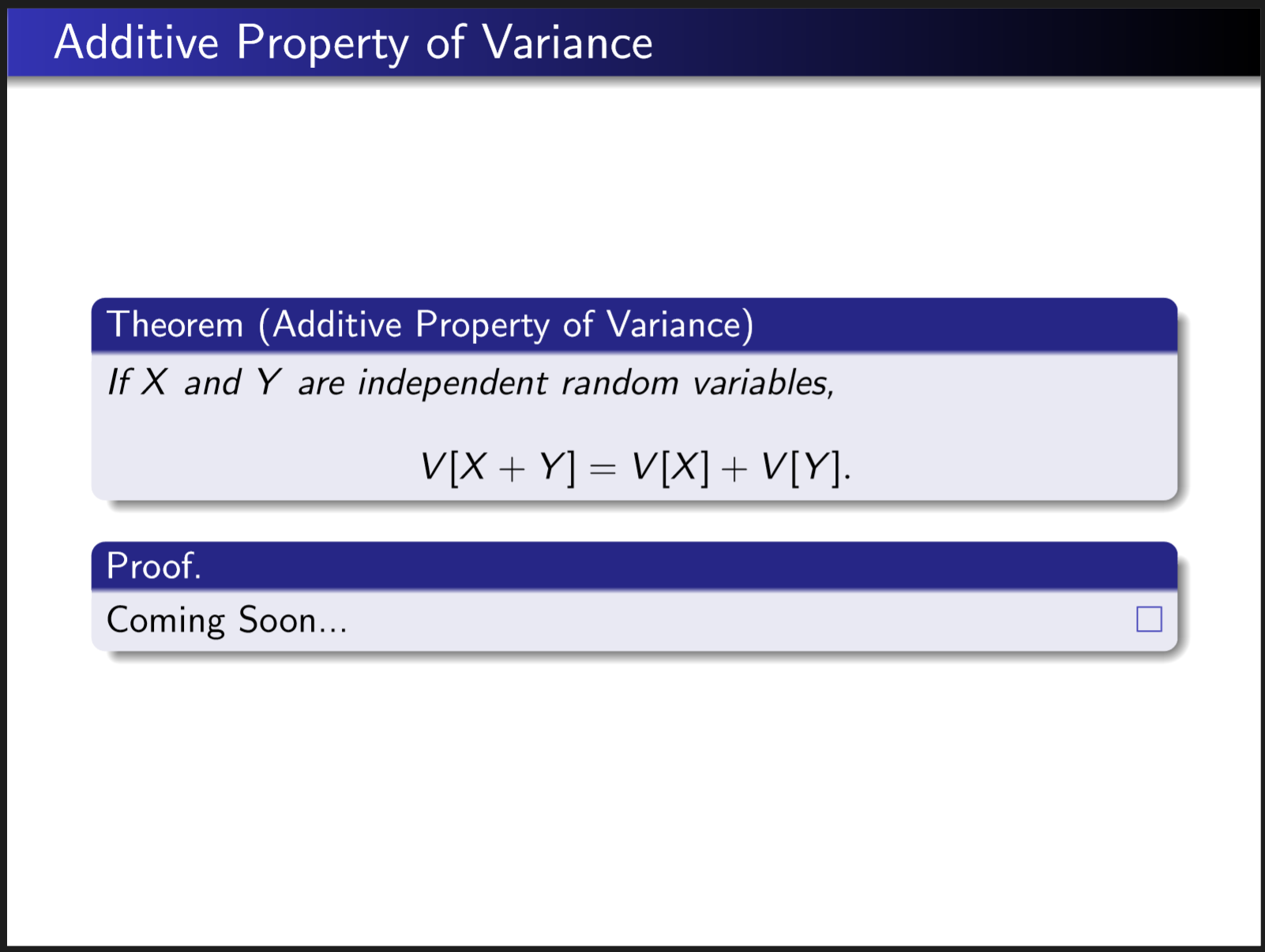

Slide 32
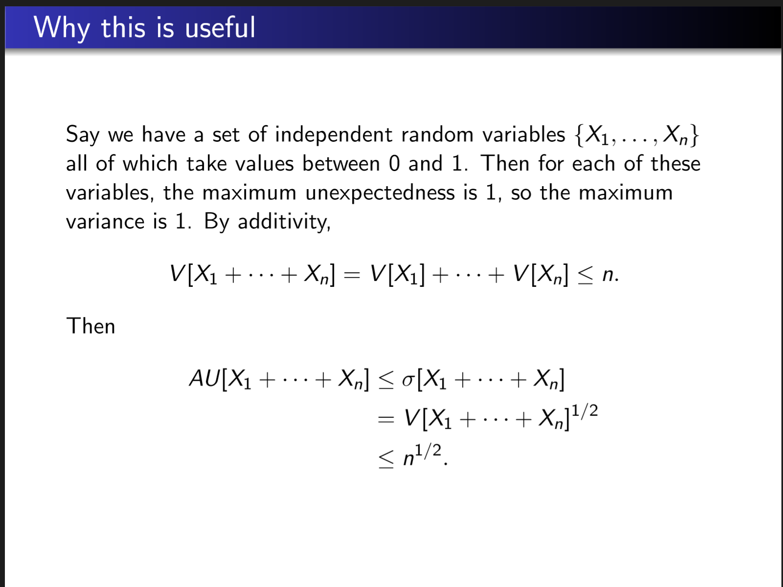

Slide 33
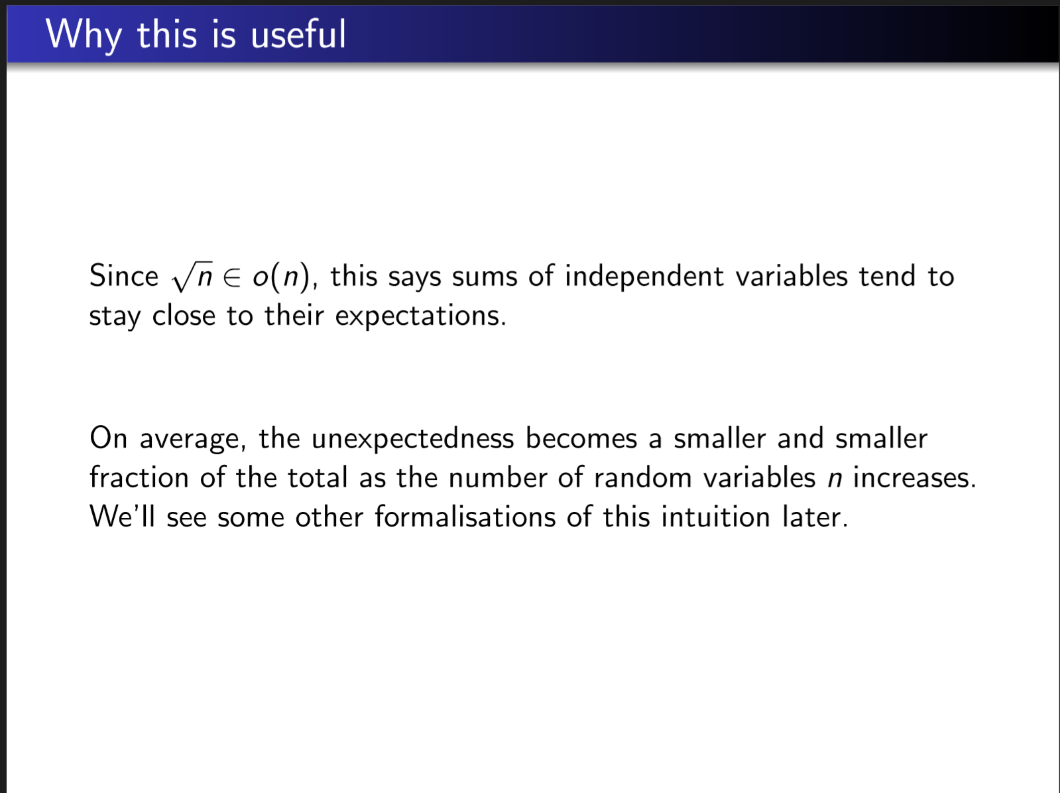

Slide 34
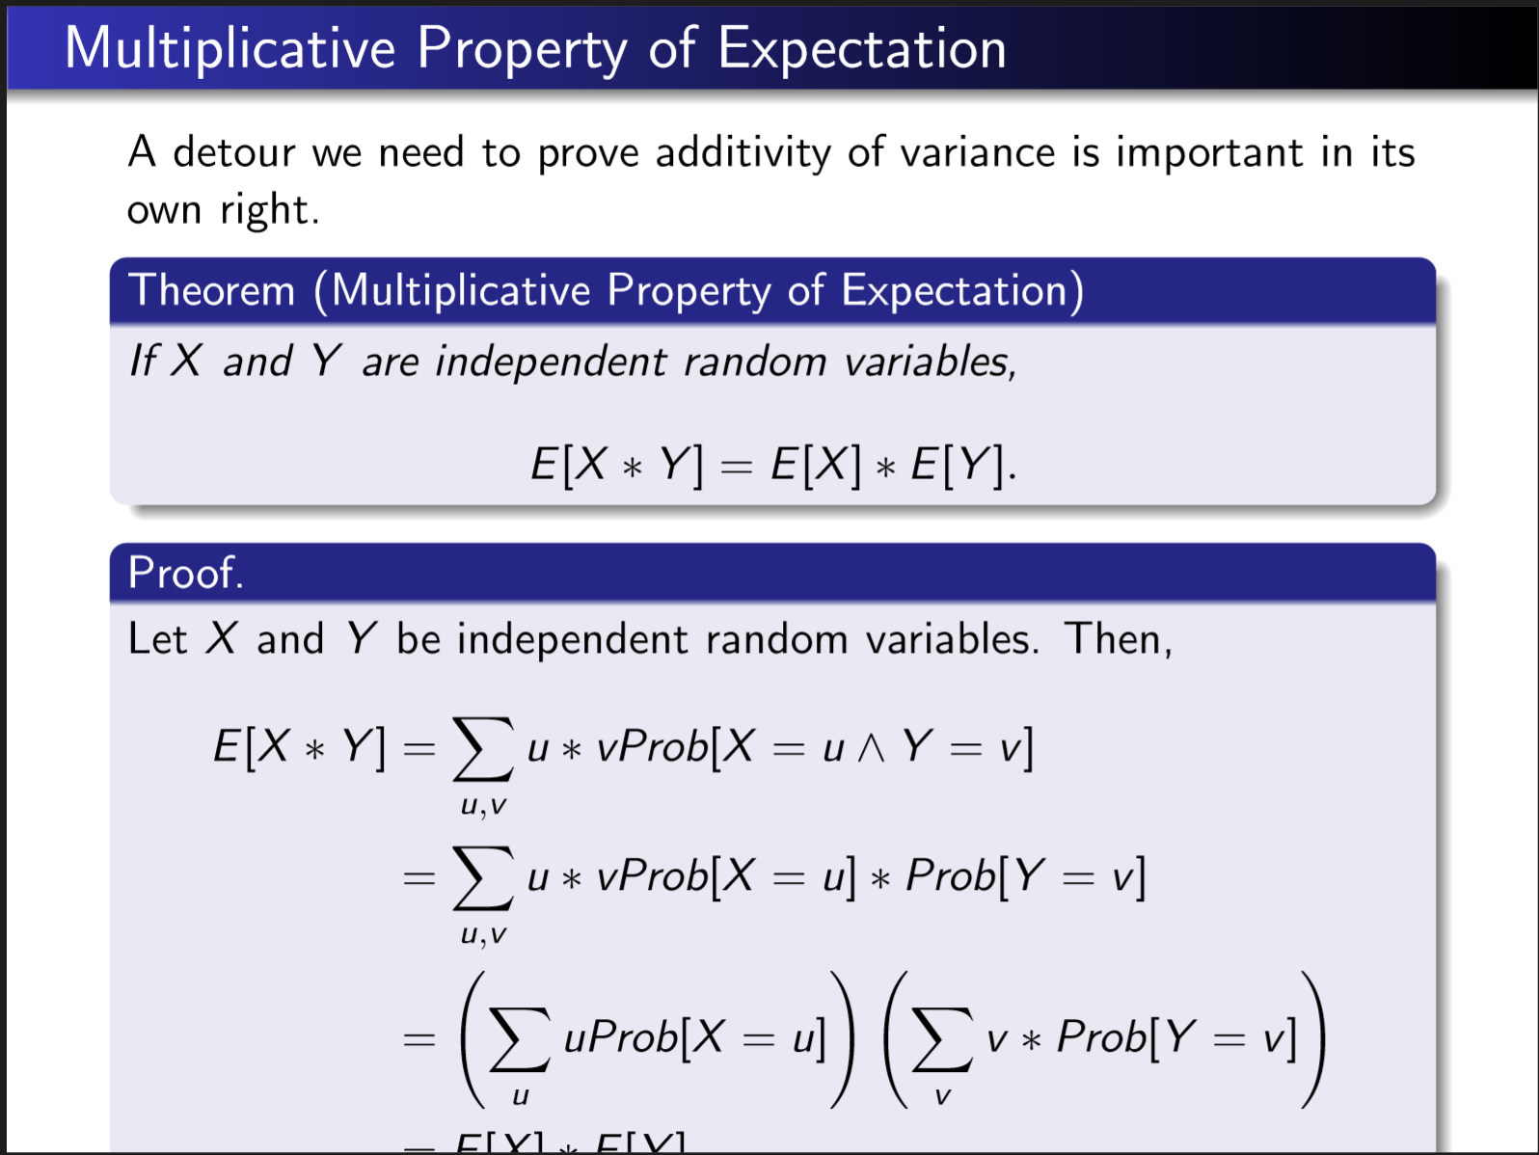

Slide 35
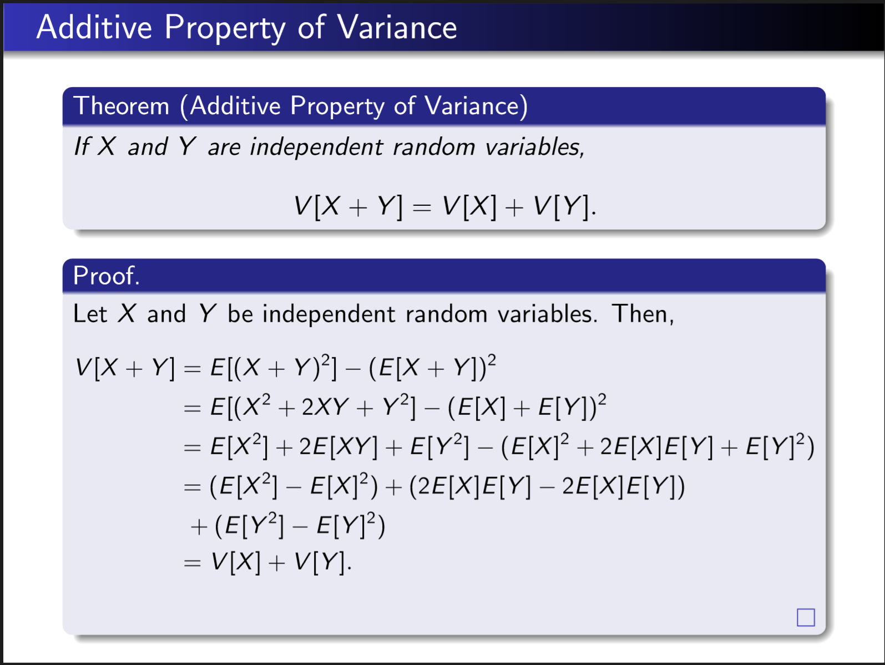

Slide 36
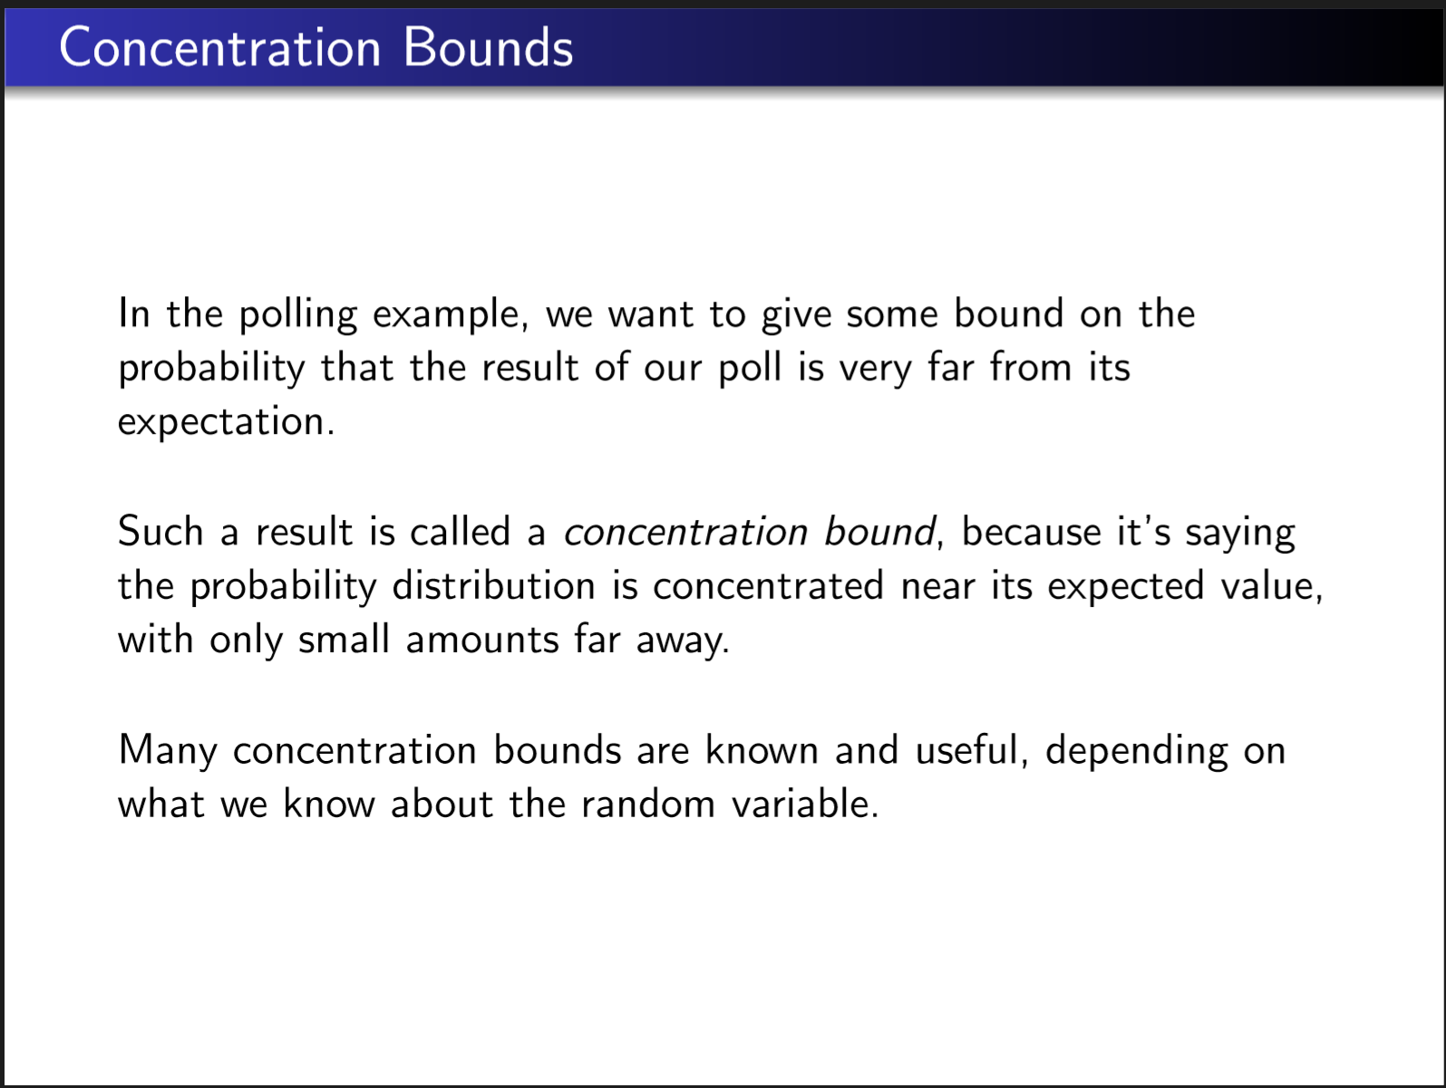

Slide 37


Slide 38
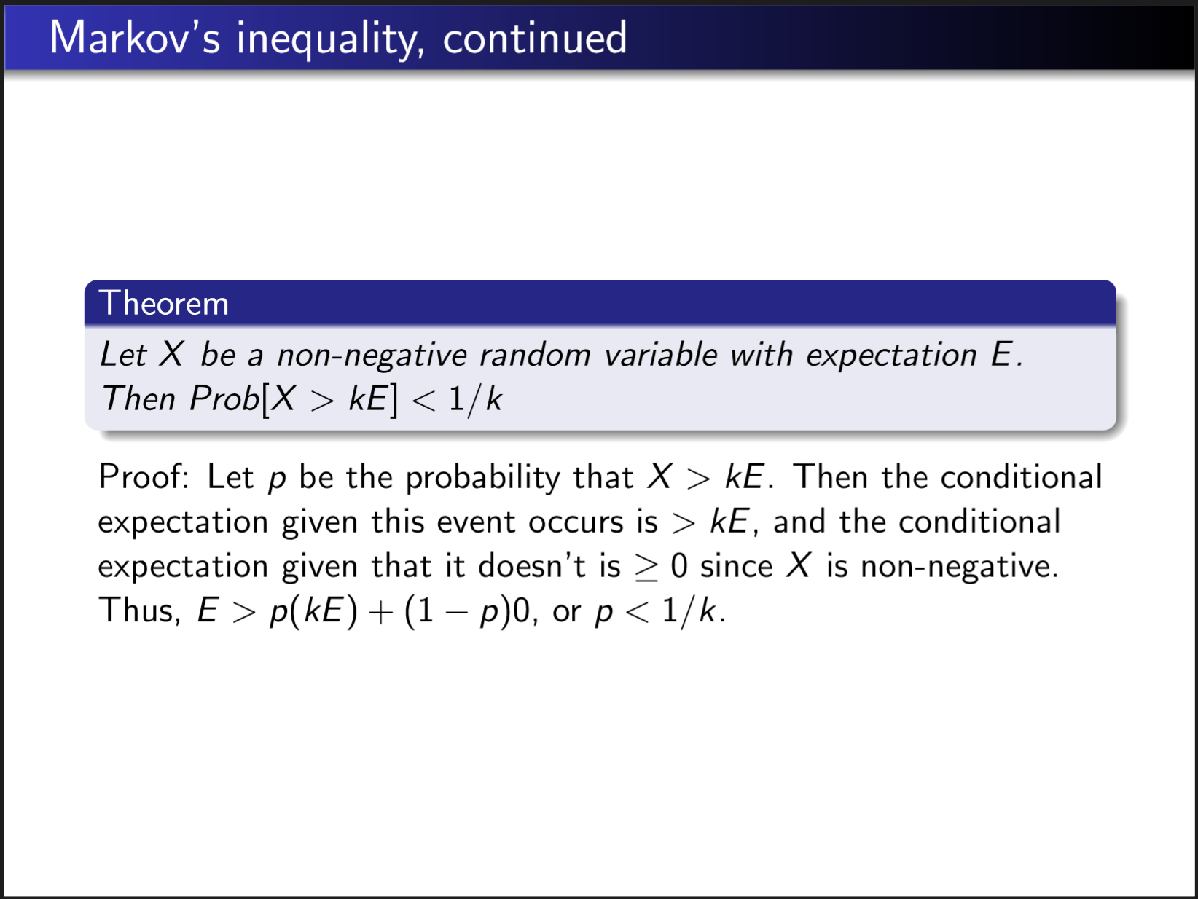

Slide 39
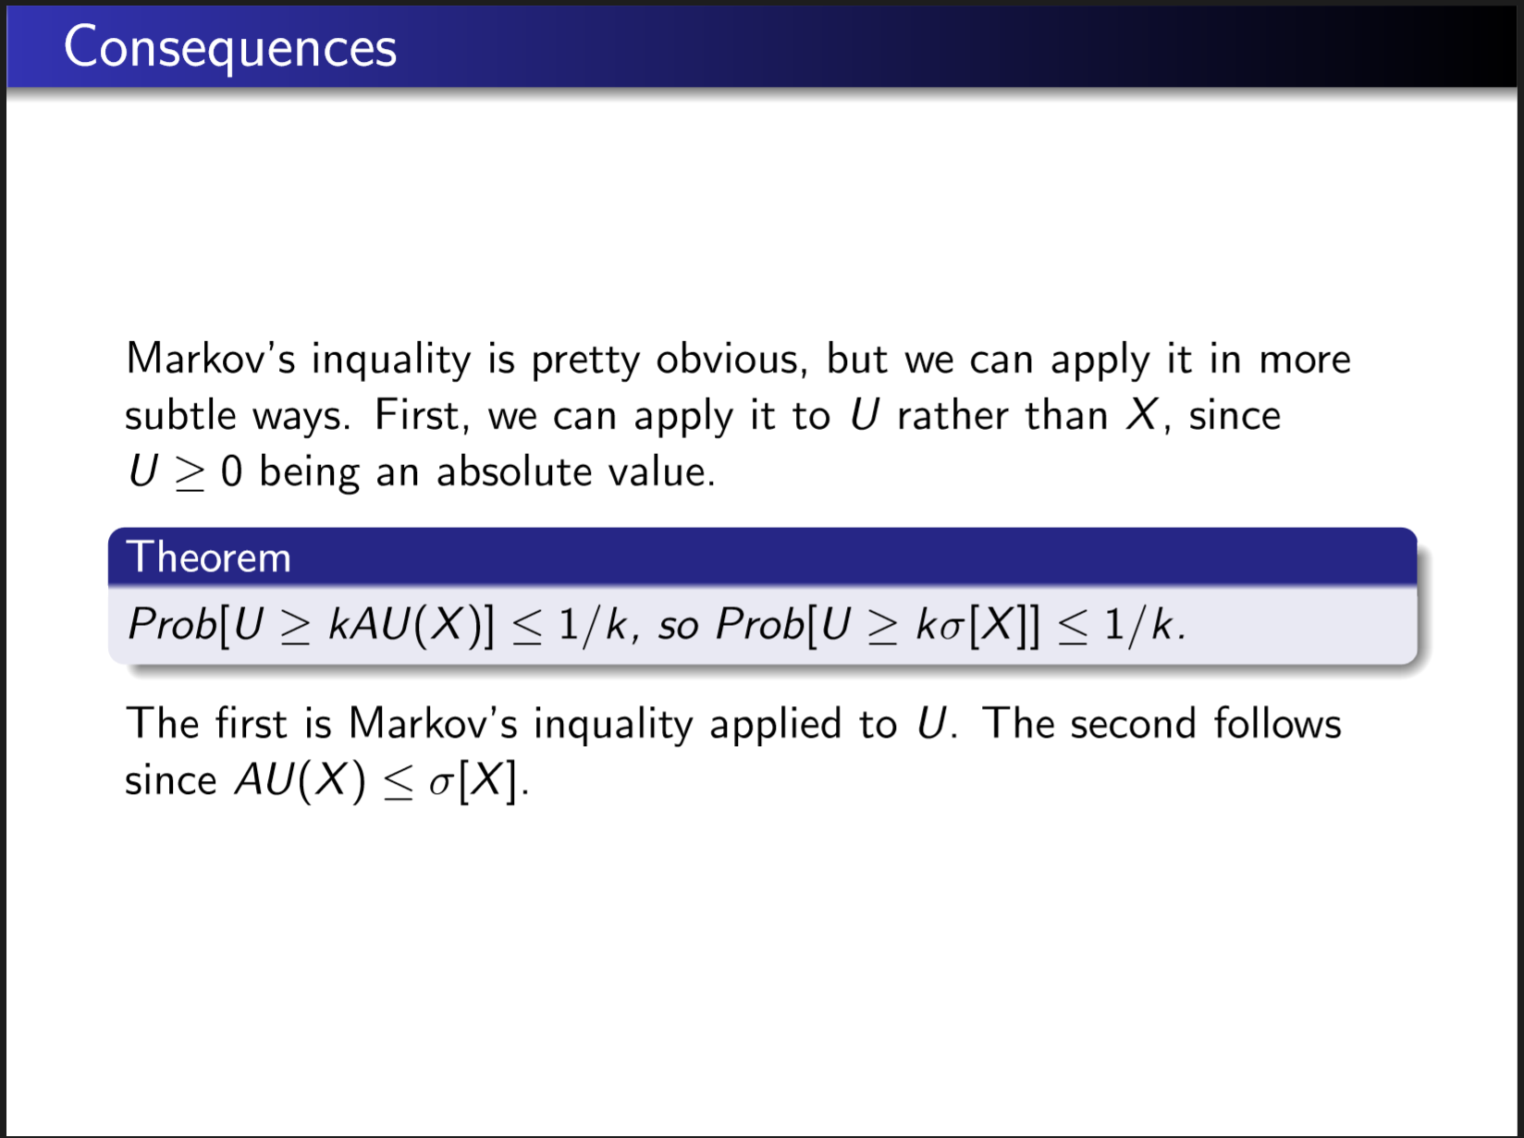

Slide 40
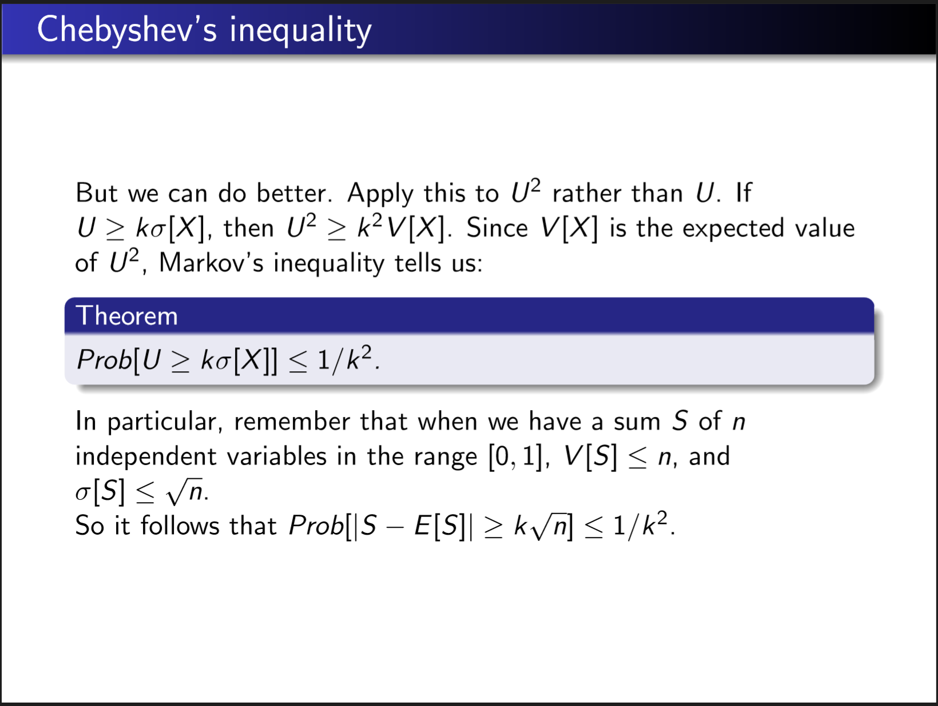

Slide 41
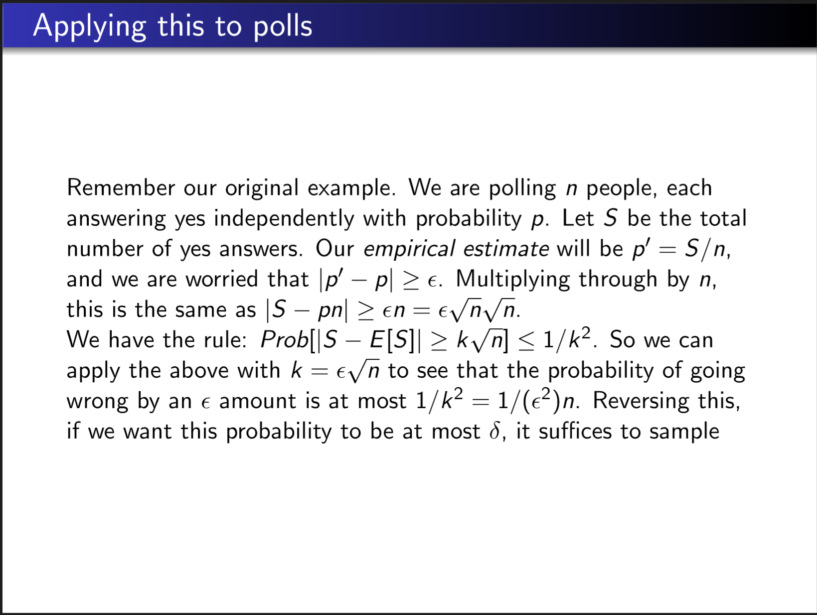
$$n=\frac{1}{δε^{2}}$$

Slide 42
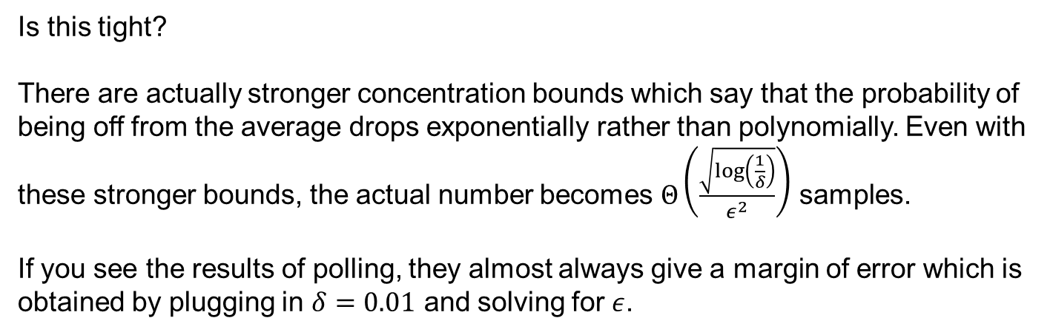
Is this tight?
There are actually stronger concentration bounds which say that the probability of being off from the average drops exponentially rather than polynomially. Even with these stronger bounds, the actual number becomes $Θ\left(\frac{\sqrt{\log\left(\frac{1}{δ}\right)}}{ε^{2}}\right)$ samples.
If you see the results of polling, they almost always give a margin of error which is obtained by plugging in $δ=0.01$ and solving for $ε$.

Slide 43
Element Distinctness: WHAT
Given list of positive integers a₁, a₂, …, a_{n} decide whether all the numbers are
distinct or whether there is a repetition, i.e. two positions i, j with 1 <= i < j <= n such that a_{i} = a_{j}.
What algorithm would you choose in general?

Slide 44
Element Distinctness: HOW
Given list of positive integers a₁, a₂, …, a_{n} decide whether all the numbers are
distinct or whether there is a repetition, i.e. two positions i, j with 1 <= i < j <= n such that a_{i} = a_{j}.
What algorithm would you choose in general? Can sorting help?
Algorithm: first sort list and then step through to find duplicates. What's its runtime?
None of the above

Slide 45
Element Distinctness: HOW
Given list of positive integers a₁, a₂, …, a_{n} decide whether all the numbers are
distinct or whether there is a repetition, i.e. two positions i, j with 1 <= i < j <= n such that a_{i} = a_{j}.
What algorithm would you choose in general? Can sorting help?
Algorithm: first sort list and then step through to find duplicates. How much memory does it require?
None of the above

Slide 46
Element Distinctness: HOW
Given list of positive integers a₁, a₂, …, a_{n} decide whether all the numbers are
distinct or whether there is a repetition, i.e. two positions i, j with 1 <= i < j <= n such that a_{i} = a_{j}.
What algorithm would you choose in general? What if we had unlimited memory?

Slide 47
Element Distinctness: HOW
Given list of positive integers A = a₁, a₂, …, a_{n} ,
UnlimitedMemoryDistinctness(A)
For i = 1 to n,
If M[a_{i}] = 1 then return "Found repeat"
Else M[a_{i}] := 1
Return "Distinct elements"
M is an array of memory locations
This is memory location indexed by a_{i}
What's the runtime of this algorithm?
None of the above

Slide 48
Element Distinctness: HOW
Given list of positive integers A = a₁, a₂, …, a_{n} ,
UnlimitedMemoryDistinctness(A)
For i = 1 to n,
If M[a_{i}] = 1 then return "Found repeat"
Else M[a_{i}] := 1
Return "Distinct elements"
M is an array of memory locations
This is memory location indexed by a_{i}
What's the runtime of this algorithm?
None of the above
What's the memory use of this algorithm?
None of the above

Slide 49
Element Distinctness: HOW
To simulate having more memory locations: use Virtual Memory.
Define hash function
h: { desired memory locations } → { actual memory locations }
Typically we want more memory than we have, so h is not one-to-one.
How to implement h?
CSE 12, CSE 100.
Here, let's use hash functions in an algorithm for Element Distinctness.

Slide 50
Virtual Memory Applications
Not just in this algorithm but in many computational settings we want to simulate a huge space of possible memory locations but where we are only going to access a small fraction.
For example, suppose you have a company of 5,000 employees and each is identified by their SSN. You want to be able to access employee records by their SSN.
You don’t want to keep a table of all possible SSN’s so we’ll use a virtual memory data structure to emulate having that huge table.
Can you think of any other examples?

Slide 52
Ideal Hash Function
Ideally, we could use a very unpredictable function called a hash function to assign random physical locations to each virtual location.
Later we will discuss how to actually implement such hash functions. But for now assume that we have a function h so that for every virtual location v, h(v) is uniformly and randomly chosen among the physical locations.
We call such an h an ideal hash function if its computable in constant time.

Slide 53
Element Distinctness: HOW
Given list of positive integers A = a₁, a₂, …, a_{n} , and m memory locations available
HashDistinctness(A, m)
Initialize array M[1,..,m] to all 0s.
Pick a hash function h from all positive integers to 1,..,m.
For i = 1 to n,
If M[ h(a_{i}) ] = 1 then return "Found repeat"
Else M[ h(a_{i}) ] := 1
Return "Distinct elements"

Slide 54
Element Distinctness: HOW
Given list of positive integers A = a₁, a₂, …, a_{n} , and m memory locations available
HashDistinctness(A, m)
Initialize array M[1,..,m] to all 0s.
Pick a hash function h from all positive integers to 1,..,m.
For i = 1 to n,
If M[ h(a_{i}) ] = 1 then return "Found repeat"
Else M[ h(a_{i}) ] := 1
Return "Distinct elements"
What's the runtime of this algorithm?
None of the above

Slide 55
Element Distinctness: HOW
Given list of positive integers A = a₁, a₂, …, a_{n} , and m memory locations available
HashDistinctness(A, m)
Initialize array M[1,..,m] to all 0s.
Pick a hash function h from all positive integers to 1,..,m.
For i = 1 to n,
If M[ h(a_{i}) ] = 1 then return "Found repeat"
Else M[ h(a_{i}) ] := 1
Return "Distinct elements"
What's the memory use of this algorithm?
None of the above

Slide 56
Element Distinctness: WHY
Given list of positive integers A = a₁, a₂, …, a_{n} , and m memory locations available
HashDistinctness(A, m)
Initialize array M[1,..,m] to all 0s.
Pick a hash function h from all positive integers to 1,..,m.
For i = 1 to n,
If M[ h(a_{i}) ] = 1 then return "Found repeat"
Else M[ h(a_{i}) ] := 1
Return "Distinct elements"
But this algorithm might make a mistake!!!
When?

Slide 57
Element Distinctness: WHY
Given list of positive integers A = a₁, a₂, …, a_{n} , and m memory locations available
HashDistinctness(A, m)
Initialize array M[1,..,m] to all 0s.
Pick a hash function h from all positive integers to 1,..,m.
For i = 1 to n,
If M[ h(a_{i}) ] = 1 then return "Found repeat"
Else M[ h(a_{i}) ] := 1
Return "Distinct elements"
Correctness: Goal is
If there is a repetition, algorithm finds it
If there is no repetition, algorithm reports "Distinct elements"

Slide 58

Element Distinctness: WHY
Given list of positive integers A = a₁, a₂, …, a_{n} , and m memory locations available
HashDistinctness(A, m)
Initialize array M[1,..,m] to all 0s.
Pick a hash function h from all positive integers to 1,..,m.
For i = 1 to n,
If M[ h(a_{i}) ] = 1 then return "Found repeat"
Else M[ h(a_{i}) ] := 1
Return "Distinct elements"
Correctness: Goal is
If there is a repetition, algorithm finds it
If there is no repetition, algorithm reports "Distinct elements" Hash Collisions

Slide 59
Element Distinctness: WHY
Given list of positive integers A = a₁, a₂, …, a_{n} , and m memory locations available
HashDistinctness(A, m)
Initialize array M[1,..,m] to all 0s.
Pick a hash function h from all positive integers to 1,..,m.
For i = 1 to n,
If M[ h(a_{i}) ] = 1 then return "Found repeat"
Else M[ h(a_{i}) ] := 1
Return "Distinct elements"
When is our algorithm correct with high probability in the ideal hash model?

Slide 60
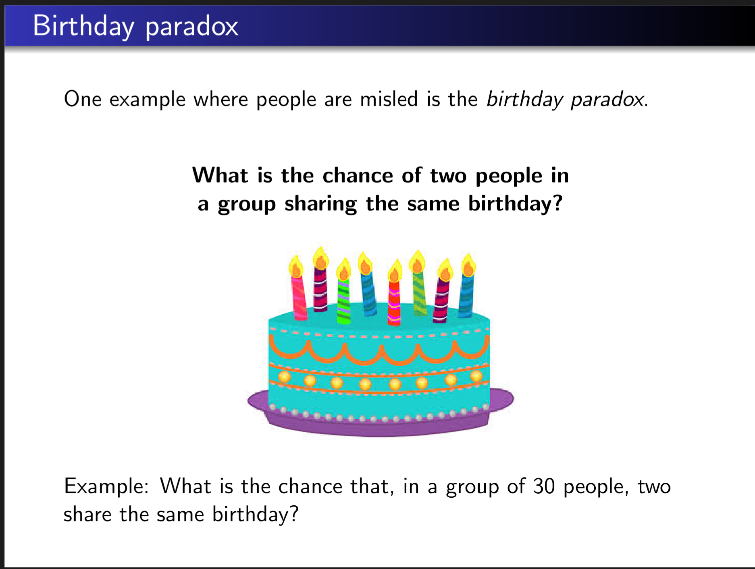

Slide 61
Where is the connection?
Think of elements in the array = people
Days of the year = memory locations
h(person)=birthday
collisions mean that two people share the same birthday.

Slide 62
General Birthday Paradox-type Phenomena
We have n objects and m places. We are putting each object at random into one of the places. What is the probability that 2 objects occupy the same place?

Slide 63

Calculating the general rule

Slide 64
Calculating the general rule
Probability the first object causes no collisions is 1

Slide 65
Calculating the general rule
Probability the second object causes no collisions is 1-1/m

Slide 66
Calculating the general rule
Probability the third object causes no collisions is (m-2)/m=1-2/m

Slide 67
Calculating the general rule
Probability the ith object causes no collisions is 1-(i-1)/m

Slide 68
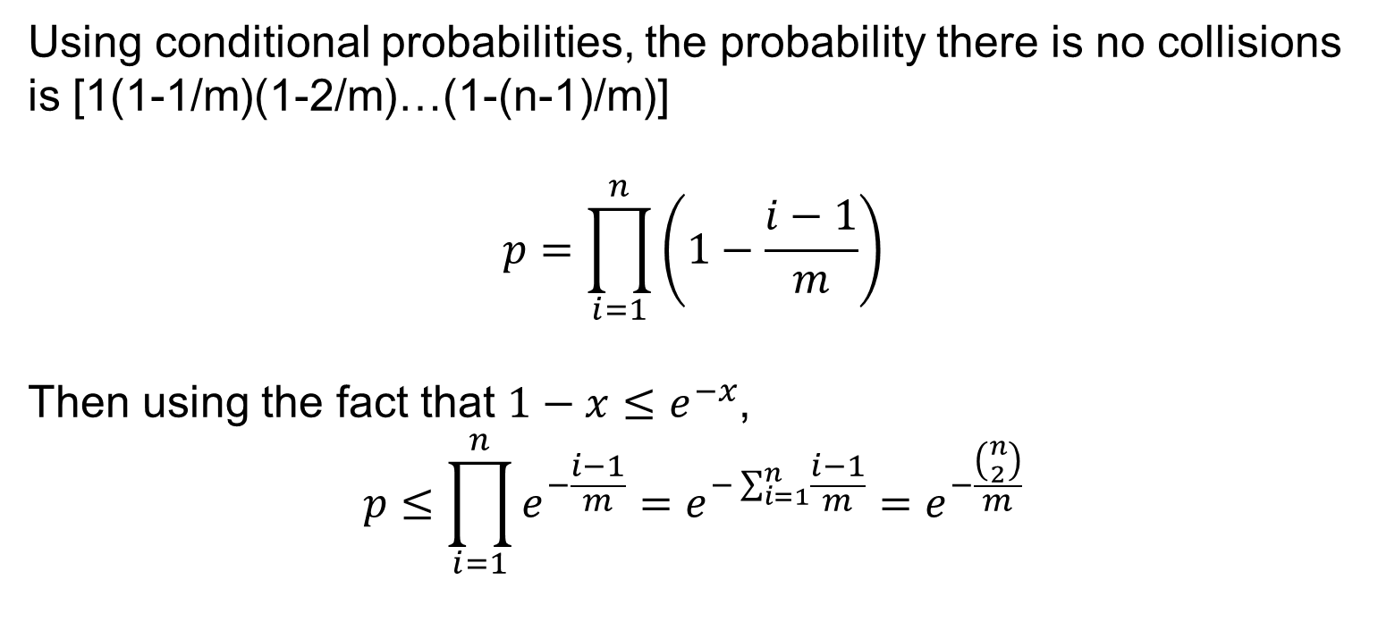
Conditional probability
Using conditional probabilities, the probability there is no collisions is [1(1-1/m)(1-2/m)…(1-(n-1)/m)]
$$p=\prod_{i=1}^{n}{\left(1−\frac{i−1}{m}\right)}$$
Then using the fact that $1−x≤e^{−x}$,
$$p≤\prod_{i=1}^{n}{e^{−\frac{i−1}{m}}=e^{−\sum_{i=1}^{n}{\frac{i−1}{m}}}}=e^{−\frac{\left({n \atop 2}\right)}{m}}$$

Slide 69
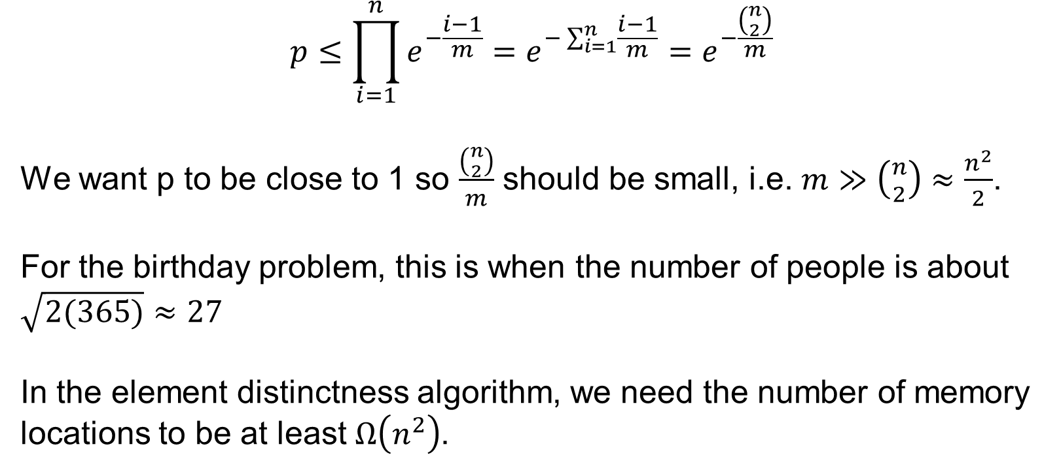
Conditional Probabilities
$$p≤\prod_{i=1}^{n}{e^{−\frac{i−1}{m}}=e^{−\sum_{i=1}^{n}{\frac{i−1}{m}}}}=e^{−\frac{\left({n \atop 2}\right)}{m}}$$
We want p to be close to 1 so $\frac{\left({n \atop 2}\right)}{m}$ should be small, i.e. $m≫\left({n \atop 2}\right)≈\frac{n^{2}}{2}$.
For the birthday problem, this is when the number of people is about $\sqrt{2(365)}≈27$
In the element distinctness algorithm, we need the number of memory locations to be at least $Ω\left(n^{2}\right)$.

Slide 70
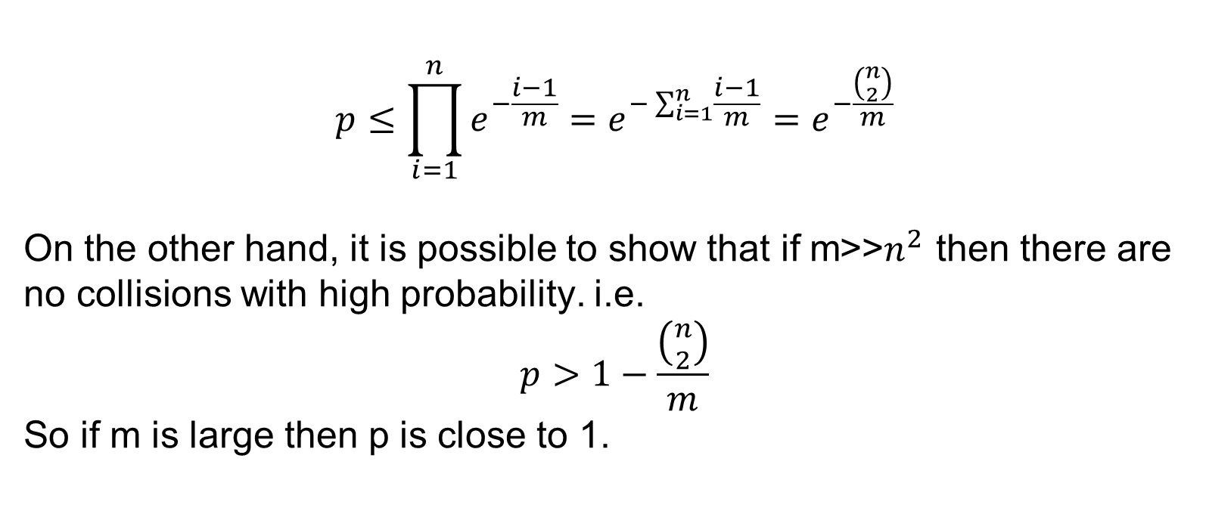
Conditional Probabilities
$$p≤\prod_{i=1}^{n}{e^{−\frac{i−1}{m}}=e^{−\sum_{i=1}^{n}{\frac{i−1}{m}}}}=e^{−\frac{\left({n \atop 2}\right)}{m}}$$
On the other hand, it is possible to show that if m>>$n^{2}$ then there are no collisions with high probability. i.e.
$$p>1−\frac{\left({n \atop 2}\right)}{m}$$
So if m is large then p is close to 1.

Slide 71
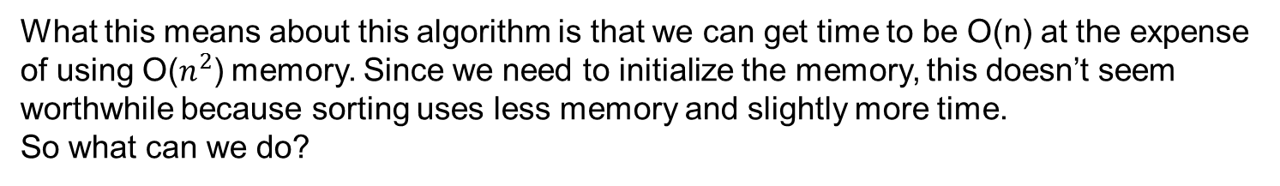
Element Distinctness: WHY
Given list of positive integers A = a₁, a₂, …, a_{n} , and m memory locations available
HashDistinctness(A, m)
Initialize array M[1,..,m] to all 0s.
Pick a hash function h from all positive integers to 1,..,m.
For i = 1 to n,
If M[ h(a_{i}) ] = 1 then return "Found repeat"
Else M[ h(a_{i}) ] := 1
Return "Distinct elements"
What this means about this algorithm is that we can get time to be O(n) at the expense of using O($n^{2}$) memory. Since we need to initialize the memory, this doesn’t seem worthwhile because sorting uses less memory and slightly more time.
So what can we do?

Slide 72
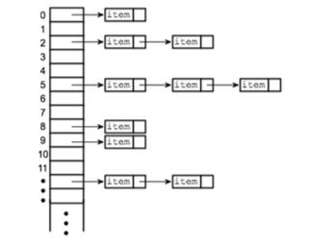
Resolving collisions with chaining
Hash Table
Each memory location holds a pointer to a linked list, initially empty.
Each linked list records the items that map to that memory location.
Collision means
there is more
than one item
in this linked list

Slide 73
Element Distinctness: HOW
Given list of positive integers A = a₁, a₂, …, a_{n} , and m memory locations available
ChainHashDistinctness(A, m)
Initialize array M[1,..,m] to null lists.
Pick a hash function h from all positive integers to 1,..,m.
For i = 1 to n,
For each element j in M[ h(a_{i}) ],
If a_{j} = a_{i} then return "Found repeat"
Append i to the tail of the list M [ h(a_{i}) ]
Return "Distinct elements"

Slide 74
Element Distinctness: WHY
Given list of positive integers A = a₁, a₂, …, a_{n} , and m memory locations available
ChainHashDistinctness(A, m)
Initialize array M[1,..,m] to null lists.
Pick a hash function h from all positive integers to 1,..,m.
For i = 1 to n,
For each element j in M[ h(a_{i}) ],
If a_{j} = a_{i} then return "Found repeat"
Append i to the tail of the list M [ h(a_{i}) ]
Return "Distinct elements"
Correctness: Goal is
If there is a repetition, algorithm finds it
If there is no repetition, algorithm reports "Distinct elements"

Slide 75
Element Distinctness: MEMORY
Given list of positive integers A = a₁, a₂, …, a_{n} , and m memory locations available
ChainHashDistinctness(A, m)
Initialize array M[1,..,m] to null lists.
Pick a hash function h from all positive integers to 1,..,m.
For i = 1 to n,
For each element j in M[ h(a_{i}) ],
If a_{j} = a_{i} then return "Found repeat"
Append i to the tail of the list M [ h(a_{i}) ]
Return "Distinct elements"
What's the memory use of this algorithm?

Slide 76
Element Distinctness: MEMORY
Given list of distinct integers A = a₁, a₂, …, a_{n} , and m memory locations available
ChainHashDistinctness(A, m)
Initialize array M[1,..,m] to null lists.
Pick a hash function h from all positive integers to 1,..,m.
For i = 1 to n,
For each element j in M[ h(a_{i}) ],
If a_{j} = a_{i} then return "Found repeat"
Append i to the tail of the list M [ h(a_{i}) ]
Return "Distinct elements"
What's the memory use of this algorithm?
Size of M: O(m). Total size of all the linked lists: O(n). Total memory: O(m+n).

Slide 77
Element Distinctness: WHEN
ChainHashDistinctness(A, m)
Initialize array M[1,..,m] to null lists.
Pick a hash function h from all positive integers to 1,..,m.
For i = 1 to n,
For each element j in M[ h(a_{i}) ],
If a_{j} = a_{i} then return "Found repeat"
Append i to the tail of the list M [ h(a_{i}) ]
Return "Distinct elements"

Slide 78
Element Distinctness: WHEN
ChainHashDistinctness(A, m)
Initialize array M[1,..,m] to null lists.
Pick a hash function h from all positive integers to 1,..,m.
For i = 1 to n,
For each element j in M[ h(a_{i}) ],
If a_{j} = a_{i} then return "Found repeat"
Append i to the tail of the list M [ h(a_{i}) ]
Return "Distinct elements"
Worst case is when we don't find a_{i}:
O( 1 + size of list M[ h(a_{i}) ] )

Slide 79
Element Distinctness: WHEN
ChainHashDistinctness(A, m)
Initialize array M[1,..,m] to null lists.
Pick a hash function h from all positive integers to 1,..,m.
For i = 1 to n,
For each element j in M[ h(a_{i}) ],
If a_{j} = a_{i} then return "Found repeat"
Append i to the tail of the list M [ h(a_{i}) ]
Return "Distinct elements"
Worst case is when we don't find a_{i}:
O( 1 + size of list M[ h(a_{i}) ] )
= O( 1 + # j<i with h(a_{j})=h(a_{i}) )

Slide 80
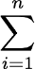
Element Distinctness: WHEN
ChainHashDistinctness(A, m)
Initialize array M[1,..,m] to null lists.
Pick a hash function h from all positive integers to 1,..,m.
For i = 1 to n,
For each element j in M[ h(a_{i}) ],
If a_{j} = a_{i} then return "Found repeat"
Append i to the tail of the list M [ h(a_{i}) ]
Return "Distinct elements"
Total time: O(n + # collisions between pairs a_{i} and a_{j}, where j<i )
= O(n + total # collisions)
Worst case is when we don't find a_{i}:
O( 1 + size of list M[ h(a_{i}) ] )
= O( 1 + # j<i with h(a_{j})=h(a_{i}) )

Slide 81
Element Distinctness: WHEN
Total time: O(n + # collisions between pairs a_{i} and a_{j}, where j<i )
= O(n + total # collisions)
What's the expected total number of collisions?

Slide 82
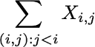
Element Distinctness: WHEN
Total time: O(n + # collisions between pairs a_{i} and a_{j}, where j<i )
= O(n + total # collisions)
What's the expected total number of collisions?
For each pair (i,j) with j<i, define: X_{i,j} = 1 if h(a_{i})=h(a_{j}) and X_{i,j}=0 otherwise.
Total # of collisions =

Slide 83
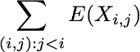
Element Distinctness: WHEN
Total time: O(n + # collisions between pairs a_{i} and a_{j}, where j<i )
= O(n + total # collisions)
What's the expected total number of collisions?
For each pair (i,j) with j<i, define: X_{i,j} = 1 if h(a_{i})=h(a_{j}) and X_{i,j}=0 otherwise.
Total # of collisions =
So by linearity of expectation: E( total # of collisions ) =

Slide 84
Element Distinctness: WHEN
Total time: O(n + # collisions between pairs a_{i} and a_{j}, where j<i )
= O(n + total # collisions)
What's the expected total number of collisions?
For each pair (i,j) with j<i, define: X_{i,j} = 1 if h(a_{i})=h(a_{j}) and X_{i,j}=0 otherwise.
Total # of collisions =
What's E(X_{i,j})?
1/n
1/m
1/n²
1/m²
None of the above.

Slide 85
Element Distinctness: WHEN
Total time: O(n + # collisions between pairs a_{i} and a_{j}, where j<i )
= O(n + total # collisions)
What's the expected total number of collisions?
For each pair (i,j) with j<i, define: X_{i,j} = 1 if h(a_{i})=h(a_{j}) and X_{i,j}=0 otherwise.
Total # of collisions =
How many terms are in the sum? That is, how many pairs (i,j) with j<i are there?
n
n²
C(n,2)
n(n-1)

Slide 86
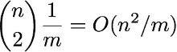
Element Distinctness: WHEN
Total time: O(n + # collisions between pairs a_{i} and a_{j}, where j<i )
= O(n + total # collisions)
What's the expected total number of collisions?
For each pair (i,j) with j<i, define: X_{i,j} = 1 if h(a_{i})=h(a_{j}) and X_{i,j}=0 otherwise.
So by linearity of expectation:
E( total # of collisions ) = =

Slide 87
Element Distinctness: WHEN
Total time: O(n + # collisions between pairs a_{i} and a_{j}, where j<i )
= O(n + total # collisions)
Total expected time: O(n + n²/m)
In ideal hash model, as long as m>n the total expected time is O(n).

